Slide 1




Unleashing Stretched Databases
Armando Lacerda MCT | MCDBA | MCSE | MCSA | MCSD.Net
me@armandolacerda.com
@arlacerda

Slide 2








Big thanks to our sponsors!

Slide 3


Slide 4
Setup
Historical Data
Backup & restore

Slide 5
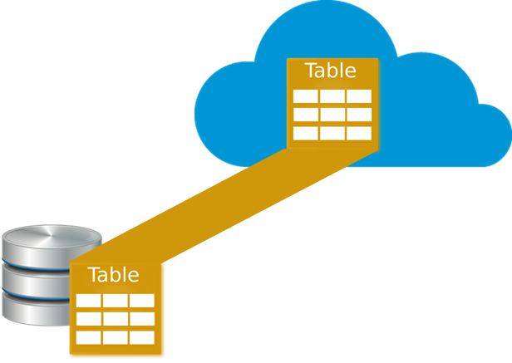
Stretched Database - PreReq
Azure Account
Compatible table
Split criteria – Optional
Network bandwidth

Slide 6

Demo - Stretched it

Slide 7
Stretched Database
Remote data
Stage Data
Local data

Slide 8
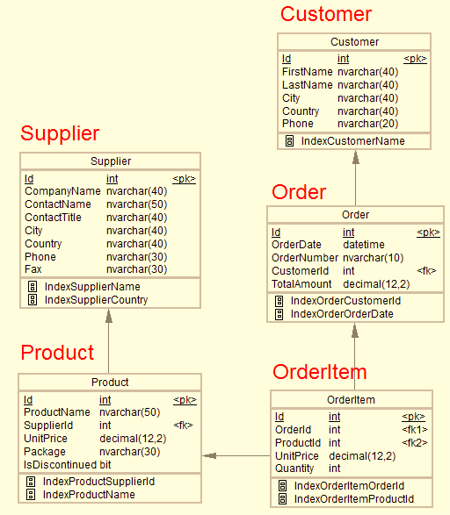
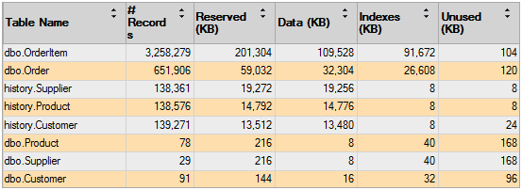
http://www.dofactory.com/sql/sample-database

Slide 9
Benefits
Cost Effective
No database schema change needed
Transparent to applications

Slide 10
Restrictions
Can’t update or delete stretched rows
Views referring to stretched tables have limited features
Can’t be the parent table of a Foreign Key constraint

Slide 11
Blocking Factors
FileStream not allowed
Memory-optimized tables not allowed
Replication, Change Tracking and CDC not allowed
Some special data types not allowed
Column_set and computed columns not allowed
Default, Check and not allowed
Full Text, XML, Spatial and indexed views indexes not allowed
Price

Slide 12
Demo - Historical data / cold data

Slide 13




Backup & Restore
Transactional Database
Automatic backup
Local replication
Geo replication
Transparent
Traditional SQL Server backup
Fraction of the database
Fraction of backup time

Slide 14
Demo - Backup & Restore

Slide 15

Questions

Slide 16
Thank you!
Some web references: https://msdn.microsoft.com/en-us/library/dn935011.aspx?f=255&MSPPError=-2147217396
https://msdn.microsoft.com/en-us/library/mt605115.aspx?f=255&MSPPError=-2147217396
https://msdn.microsoft.com/en-us/library/mt762899.aspx
https://msdn.microsoft.com/en-us/library/mt733205.aspx

